Slide 1
TRENDS IN ASSESSMENT
A data-driven approach to analyze the performance of the Indiana Assessment system in context of sales

Slide 2
Background
How are Assessments in Indiana derived?
What kind of quality controls are in place for Assessments in Indiana?
Is it important to have State-wide assessment uniformity?
DLGF and their role in assessment oversight
IAAO and their role in global assessment administration and publication of technical standards
Incorporation of generally accepted statistical practice
Indiana written level of assessment based on recommendation of the IAAO technical standard committee.
IAAO & the committee of technical standards continues to advance and publish standards on the science and mathematics of assessment and mass appraisal

Slide 3
Terms
Mass Appraisal: The process of valuing a group of properties as of a given date, using standard methods, employing common data, and allowing for statistical testing.
Market Value: The most probable price, as of a specified date, in cash, or in terms equivalent to cash, or in other precisely revealed terms, for which the specified property rights should sell after reasonable exposure in a competitive market under all conditions requisite to a fair sale, with the buyer and seller each acting prudently, knowledgeably, and for self interest, and assuming that neither is under undue duress.
Ratio Study: A study of the relationship between appraised or assessed values and market values. Indicators of market values may be either sales (sales ratio study) or independent “expert” appraisals (appraisal ratio study). Of common interest in ratio studies are the level of uniformity of the appraisal or assessments.
2011 Prop Manual

Slide 4
Terms, Continued
Value-in-Use: The value of property for a specified use. The concept that holds value to be inherent in property itself, that is, the value is based on the ability of the asset to produce revenue through ownership. ▼ The value a specific property has for a specific use. Synonymous with Use Value and Market Value-in-Use
Sales Price: The actual amount of money exchanged for a unit of goods or services, whether or not established in a free and open market.
Valuation Date: The specific date as of which assessed values are set for purposes of property taxation. ▼ The date as of which the true tax value of the property is estimated. In the case of the 2021 general reassessment, this would be January 1, 2021. An indicator of market value.

Slide 5
Methodology – 2011 Property Manual
There are a multitude of models that have been developed for the mass appraisal process by assessing officials, vendors, and academics. Any of these models may be capable of producing accurate and uniform values for a particular class of property within a specified geographic area. However, not all models can be used for every type of property or in every jurisdiction nor do they all offer ease in administration. The market dictates what type of models should be used and administrative constraints, such as knowledge of the user and budget concerns, dictate what models can be used. Whatever mass appraisal method(s) and model(s) a county chooses, they must be capable of producing accurate and uniform values throughout the jurisdiction and across all classes of property.

Slide 6
Guidance from IBTR: MEIJER STORES LP VS Boone County Assessor
92. The MANUAL offers further guidance. It defines “market value-in-use,” “value in use,” and “use value,” as being synonymous. MANUAL at 6-8. But it also states that a property’s true tax value will equal its value-in-exchange when properties are frequently exchanged and used for the same purposes by the buyer and seller. Id. at 2, 4.
93. True tax value is something other than purely market value or value-in-use. Given the mandates from the Indiana Supreme Court and the Legislature, the DLGF created a valuation standard that relies heavily on what it terms as objectively verifiable data from the market, but still maintains the notion of property wealth gained through utility, and therefore recognizes situations where true tax value will differ from market value.

Slide 7
Standards on Level of Assessment
The standard that is used to connect the legislative definition of value to practical valuations used to ultimately compute assessments.
Sec. 5. (a) Except for agricultural land, ratio study statistics shall be calculated based on the methods and procedures contained in the IAAO Standard on Ratio Studies (July 2007), as incorporated by reference in 50 IAC 27-1-4. (b) The level of assessment, as determined by the median ratio, must fall between 0.90 and 1.10 for any class of property. However, confidence intervals, rather than the median ratio itself, will be used to determine compliance with this benchmark.

Slide 8
Level of Assessment - IAAO 2013 Guide to Ratio Studies
5.3 Measures of Appraisal Level Estimates of appraisal level are based on measures of central tendency. They should be calculated for each stratum and for such aggregations of strata as may be appropriate. Several common measures of appraisal level (central tendency) should be calculated in ratio studies, including the median ratio, mean ratio, and weighted mean ratio. When one of these measures is calculated on the data in a sample, the result is a point estimate, which is accurate for the sample but is only one indicator of the level of appraisal in the population. Confidence intervals around the measures of level provide indicators of the reliability of the sample statistics as predictors of the overall level of appraisal of the population. Note that noncompliance with appraisal level standards cannot be determined without the use of confidence intervals or hypothesis tests.

Slide 9
When Should an Oversight Agency Reject a Group of Assessments?

Slide 10
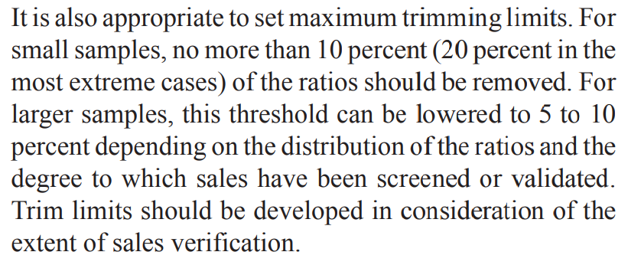
N & Vital Trimming Stats - IAAO
Trimming Limitation: IAAO 2013 Guide to Ratio Studies p.54

Slide 11
N & Vital Trimming Stats - DLGF
However, if your county’s 2018 valid for trending percentages are below the targeted thresholds of 35% (for all submitted sales records) and/or 55% (for all submitted sales that are marked valuable for consideration and fee eligible), the Department’s Assessment Division may be following up with you to coordinate an opportunity to meet and discuss the processes in place for reviewing and validating sales.

Slide 12
Examples of Actual 2018 Trimming Results:

Slide 13
Hypothesis
The Indiana system allows the local assessors to trim over 2X-3X more sales than recommended by the IAAO Guide to Ratio Studies under normal circumstances.
The broad freedom of the local assessor to filter sales could impact state wide assessment uniformity. This impact could be valuable or detrimental.
THE HYPOTHESIS: excessive sale filtering leads to underassessment as most assessors would rather remove sales than facilitate dramatic assessment increases.

Slide 14
Hypothesis Explained
Anecdotes of public perception that assessments < value/sales
Broad/vague reasons for sale removal as reported on the ratio studies
Hesitation to adopt modern technical standards and modify existing technical standards in 50IAC
Difference in mass appraisal and single property appraisal processes and evidence

Slide 15
Developing a Level of Assessment Test for Indiana
Data driven from public information requests
Mitigate/eliminate bias
Determine necessary sample size necessary for credibility
Obtaining accurate data

Slide 16
The Process
Obtain 92 “sale files” from 2018 to create a statewide database of every sales that occurred between 1/1/2018 and 12/31/2018.
Assign every sale in the study a unique pin number.
Determine the necessary sample size (N)
Draw unique sale pin numbers via a random number generator. We used www.random.org.
Categorize the selected sales by property class category
Trim data for outliers
Run a ratio study and descriptive statistics for each property class

Slide 17
Interim Results Residential
Null Hypothesis: the median ratio for residential property exceeds .9
We fail to reject the null hypothesis

Slide 18
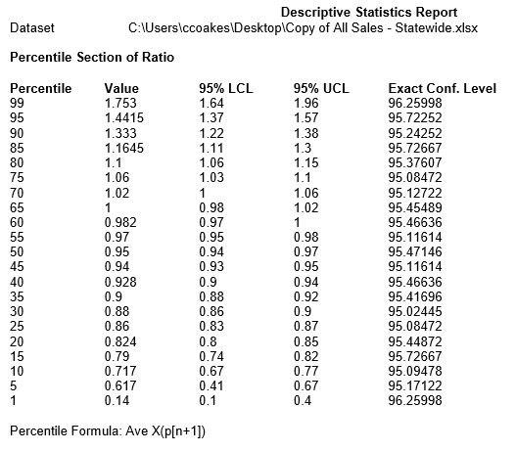
Residential Ratio Percentile

Slide 19
Interim Results Commercial
Null Hypothesis: the median ratio for C&I property exceeds .9
We fail to reject the null hypothesis – more data needed!

Slide 20
Discussion of Results
Implication that local control and valuation of residential property is more accurate than hypothesized.
Supports the concept of a replacement cost base value for residential property
Are commercial/Industrial property underassessed, are sales not they best valuation proxy or perhaps both play a factor?

Slide 21
Tax Policy Implications
How important/valid is the equitability argument in appeals
Are sales a good proxy for all classes of property?
Is the valuation process being used to set tax policy informally?

