Slide 1
Understanding the Impact of New Legislation on Assessments
6-1.1-4-39 (Section 39)

Slide 2
Background
Three generally accepted methods to value property: income capitalization, sale comparison and replacement cost approaches
https://completerea.com/2014/09/17/uspap-standard-rule-1-4/
Under the provisions of Title XI of the Financial Institutions Reform, Recovery and Enforcement Act of 1989 (FIRREA), the Appraisal Standards Board (ASB) is responsible for writing, amending, and interpreting the Uniform Standards of Professional Appraisal Practice (USPAP).

Slide 3
STATE BOARD OF TAX COMMISSIONERS v. TOWN OF ST JOHN (1998)
We affirm the Tax Court's determination that the existing cost schedules, lacking meaningful reference to property wealth and resulting in significant deviations from substantial uniformity and equality, violate the Property Taxation Clause of the Indiana Constitution. However, the Clause does not require the consideration of all property wealth evidence in individual assessments or appeals therefrom. It does not mandate the use of strict market value or the use of its three measurement standards. It does not prohibit the use of different assessment methodologies for differing property classifications, or assessment based on value in use, provided that the result is substantial uniformity and equality based on property wealth across all property classifications.

Slide 4
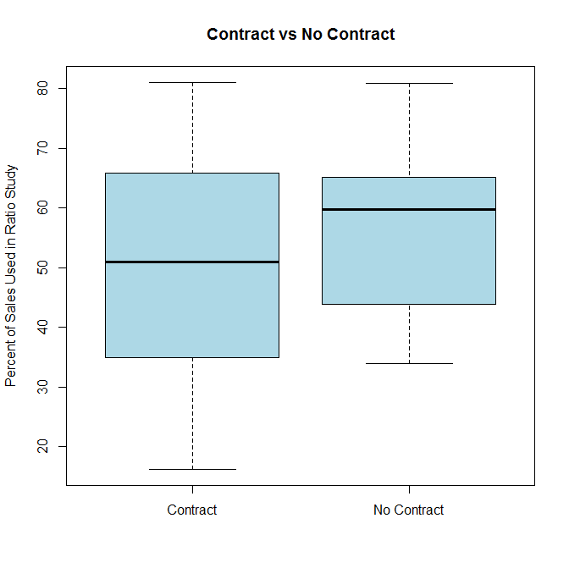
Is Indiana market value 20+ years later?
https://www.opensourceassessing.com/research

Slide 5
Lowest of the 3 for apartments: 2005-2023
(a) For assessment dates after February 28, 2005, except as provided in subsections (c) and (e), the true tax value of real property regularly used to rent or otherwise furnish residential accommodations for periods of thirty (30) days or more and that has more than four (4) rental units is the lowest valuation determined by applying each of the following appraisal approaches:
(1) Cost approach that includes an estimated reproduction or replacement cost of buildings and land improvements as of the date of valuation together with estimates of the losses in value that have taken place due to wear and tear, design and plan, or neighborhood influences.
(2) Sales comparison approach, using data for generally comparable property.
(3) Income capitalization approach, using an applicable capitalization method and appropriate capitalization rates that are developed and used in computations that lead to an indication of value commensurate with the risks for the subject property use.

Slide 6
2023 Valuation Project: Campus Student
https://www.tippecanoe.in.gov/1224/2023-Campus-Student-Housing-Project

Slide 7
Lowest of the 3 for apartments: 2024
(f) Notwithstanding IC 6-1.1-4-4.5, for assessment dates beginning after December 31, 2023, the county assessor or township assessor making the assessment shall perform an assessment of property qualifying under subsection (a) annually, and for each assessment year, perform a valuation of the property qualifying under subsection (a) using each of the appraisal approaches in subsection (a)(1)through (a)(3) and annually report to the taxpayer each of the values under those approaches as determined by the assessor on a form as prescribed under subsection (i).The assessor shall use the department cost schedules without modifiers, adjustments, or other trending factors.
(g) The county assessor or township assessor making the assessment of property qualifying under subsection (a) has the burden of proof to establish that the assessment is correct and that the assessed value is the lowest value of those determined using the three (3) appraisal approaches performed by the county assessor or township assessor regardless of the percentage change in the assessed value.
(h) Upon request of the taxpayer, the county assessor or township assessor making the assessment shall provide an explanation to the taxpayer concerning how the assessed value of the property was calculated.
(i) The department shall prescribe a specific form for property qualifying under subsection (a).

Slide 8
Proposed DLGF solutions
https://storymaps.arcgis.com/stories/4ad7515ae31045bba6259ffa24c84707
RESIDENTIAL LCM CHECK (arcgis.com)

Slide 9
Guess that AV!
FUSE: 2023 TTV of 67.3M
https://venturi.blob.core.windows.net/fd-2286/79-07-18-462-015.000-026/3?sv=2015-07-08&sr=b&sig=Qx8qOKHXWe7kk5CFrWqP0kkAzE0FOF2jY6GDaWgSg5A%3D&se=2024-02-02T07%3A00%3A00Z&sp=r&rscd=inline%3B%20filename%3D%2279-07-18-462-015.000-026_3.pdf%22

Slide 10
Obvious Equity Problems
Regressive tax policy construed against owners of single family through 4-unit rentals. Creates two valuation standards for residential rental property in Indiana.
Mixed use buildings: Not clear how to separate non-apartment uses on the same parcel. Could create disparity between office, retail, restaurant, etc.
Some classes of properties tied to market value: apartments, AG land and golf courses excluded.

Slide 11
Solution #1
Drastically reduce apartments while continuing with market value for other classes of property
Pro: minimize damage to the community
Con: regressive & unconstitutional

Slide 12
Solution #2
Reduce all property assessments to a similar proportion of market value as now is required for apartments
Pro: fair & equitable
Con: maximum damage to the community

Slide 13
Solution #3
Inflate grades & pursue legal change
Pro: allows more time to problem solve
Con: might be kicking the can down the road

